Slide 1


Quartz Kingdom
INDIA

Slide 2














Page Direction Keys
Quartz Kingdom
INDIA
Notes:
Menu

Slide 3

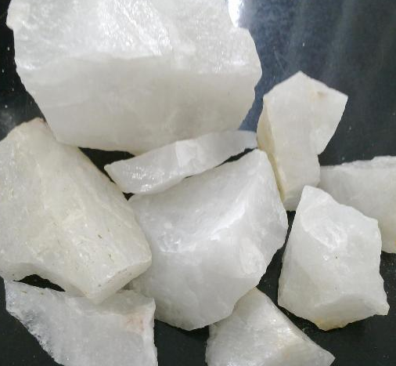

Quartz Kingdom
Diamond stone industries
About us...
Diamond stone industries is one of the venture of MARK group; is engaged in processing of quartz, the company was promoted in 2011 by highly industrial experienced professional’s team,
The company has setup fully automatic processing facilities of quartz granules and powder; also having mines in Gujarat and Rajasthan states of India, with overall processing capacity of 250 metric tons per day for granules, powder and lumps
Quartz Kingdom
Notes:
About Us

Slide 4
Quartz Kingdom
Our
History
1996 Altis Finechem Pvt.Ltd. Bulk Drug Manufacturing
1997 Nijanand Ceramics Pvt. Ltd. Ceramic Tiles Manufacturing
2002 Crystal Glazes. Ceramic Glaze Manufacturing
2003 Crystal Ceramics Pvt. Ltd. Porcelain Tiles Manufacturing
2010 Mark Alloys Pvt.Ltd . M.S. Structure Pipe Manufacturing
2011 Diamond Minerals. Minerals Processing Unit
2012 Deep Alloys –II M.S. Billets Manufacturing
2015 Divine Mine Chem. Precision Minerals Processing
2015 Mark Fincorp Services . Financial Services
Diamond stone industries

Slide 5
Quartz Kingdom
DIAMOND STONE INDUSTRIES
Vision - Mission
Vision
Mark group has core ethics of doing business with a vision of enhancing value for their customer and associates
Mission
  It is a mission to process premium minerals, considering international and national standards for global users

Slide 6
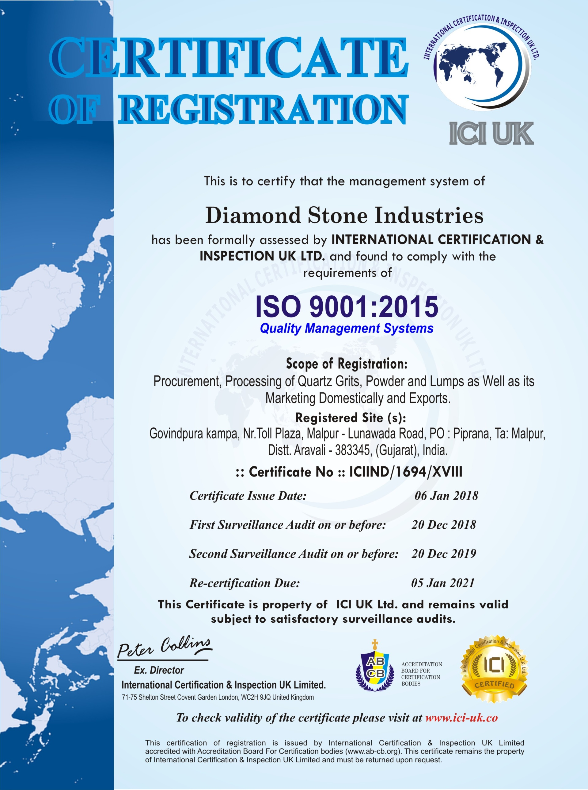
Quartz Kingdom
Quality Certificate
Diamond Stone Industries is having ISO 9001:2015 ; Quality Management Systems,
We have system to check quality from procurement of lumps to finish goods; as per required specified quality,
We are having fully equipped quality control system for sieve analysis and whiteness checking system at plant premises,
Also we are in practice of doing third party chemical analysis for lot to lot for batter quality assurance,

Slide 7
Quartz Kingdom
Information
IMPORT EXPORT NO . 0811010074
FACTORY LACENSE NO . 17926
GST NO . 24AAHFD8399L1ZR
PAN NO . AAHFD8399L
OWNER HARSHADKUMAR NARAYANBHAI PATEL
Cont. +91 97234 52701
Email. Id. diamondstoneindustries@gmail.com
SANJAYKUMAR KANTILAL PATEL
Cont. +91 97234 61701
Email. Id. diamondstoneindustries@gmail.com
DIAMOND STONE INDUSTRIES

Slide 8
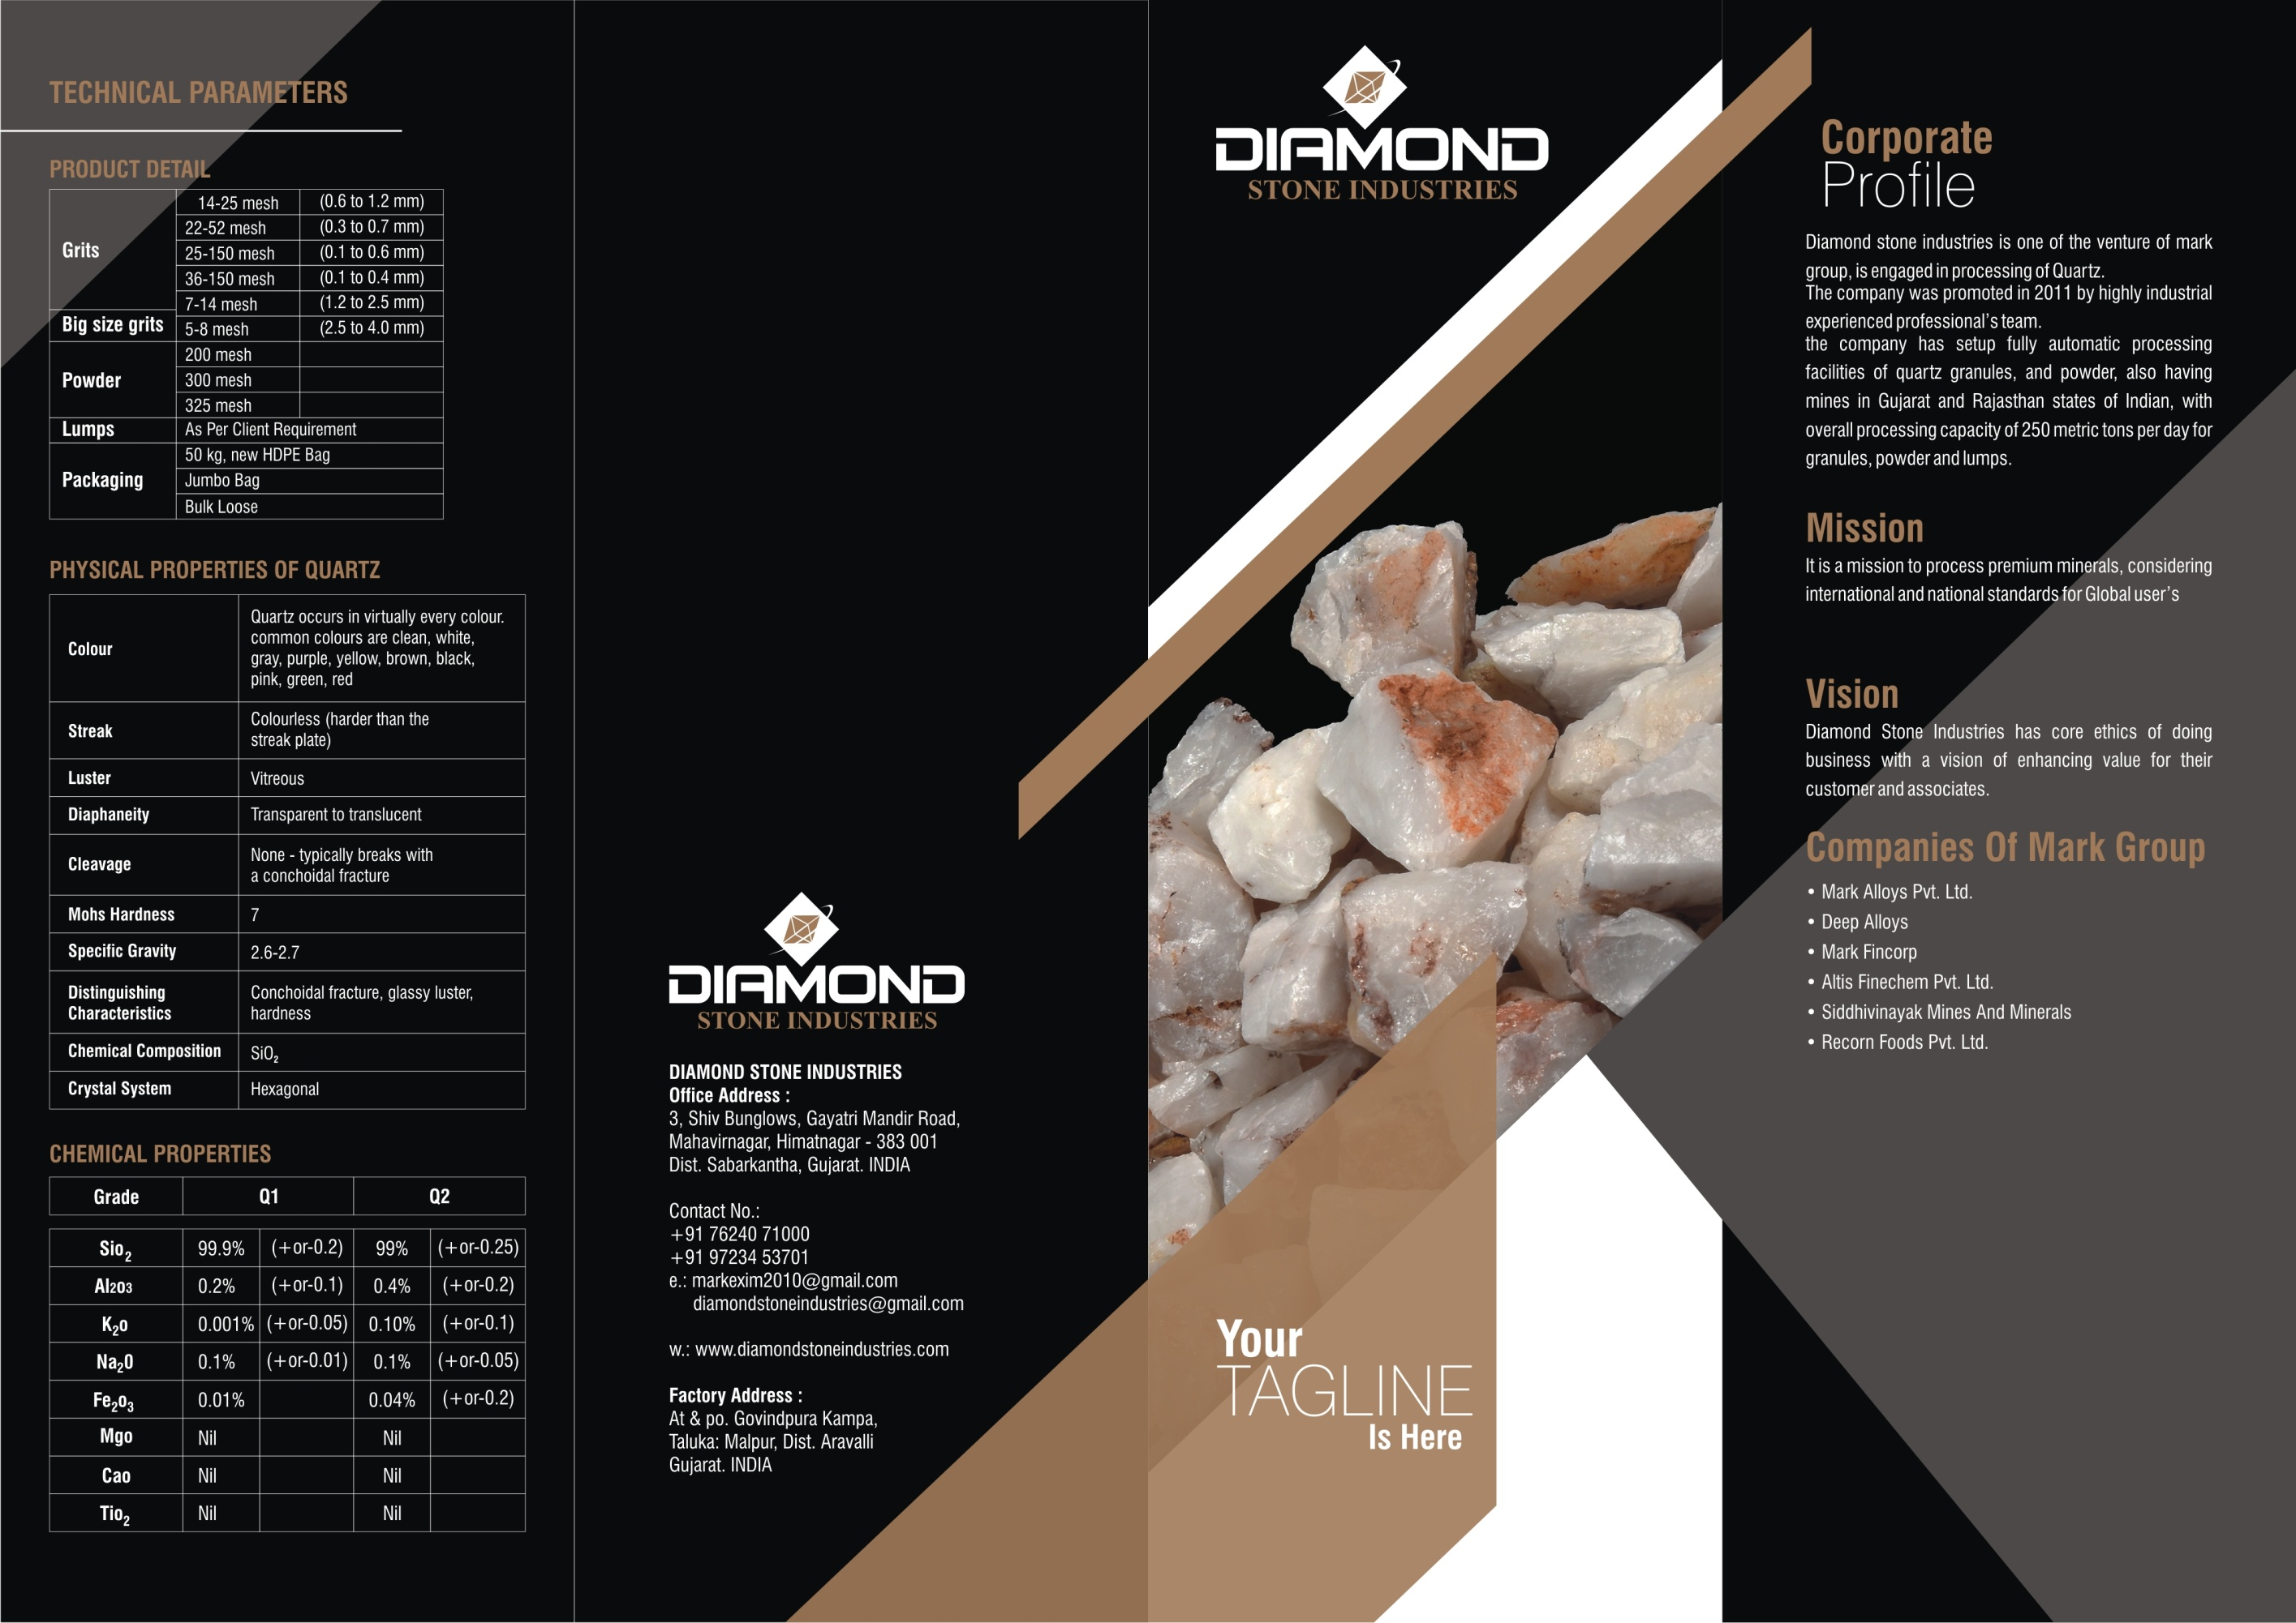
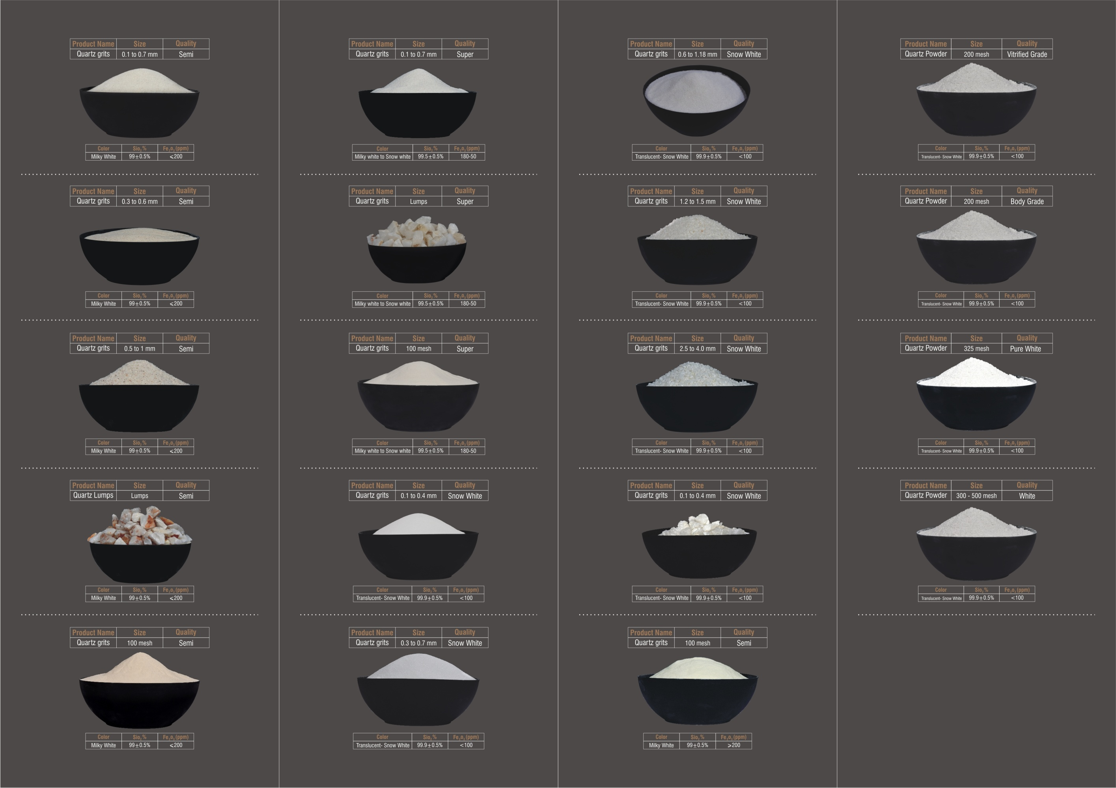
Quartz Kingdom
Product Catalogue

Slide 9
PRODUCTION CAPACITY
Diamond stone industries
GRITS
POWDER
LUMPS
6 UNITS
MACHINERY TYPE:
DIS INDICATER ,30/80 UNITS,
TOTAL NO 6
CAPACITY :
800 TO 1100 MT / UNIT / MONTH
TOTAL CAPACITY :
4800 TO 6600 MT / MONTH
SIZE
0.6 to 1.2 mm
0.3 to 0.7mm
0.1 to 0.6mm
0.1 to 0.4mm
1.2 to 2.5mm
2.5 to 4.0mm
3 UNITS
MACHINERY TYPE :
BALL MILL SELF MEDIA
CAPACITY :
750 TO 1000 MT / UNIT / MONTH
TOTAL CAPACITY :
2100 TO 3000 MT / MONTH
SIZE
200 Mesh
300 Mesh
325 Mesh
400 Mesh
1 UNIT
MACHINERY TYPE:
CRUSHER
CAPACITY:
5000 MT./ MONTH
SIZE
As Per Client Requirement

Slide 10
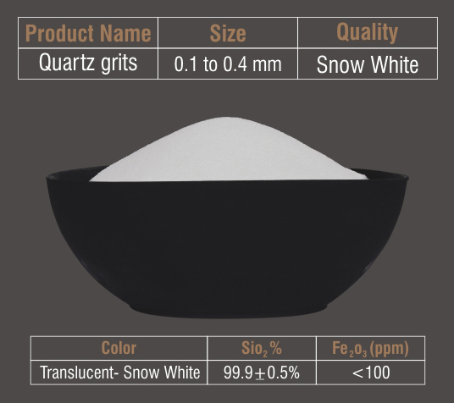
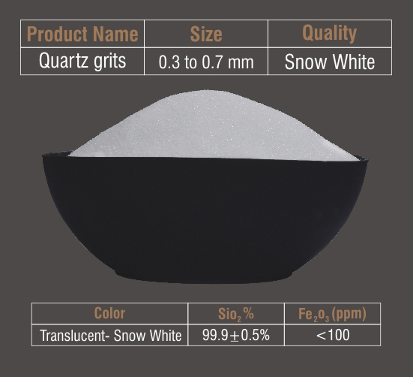




Quartz Kingdom
Snow White
Diamond stone industries

Slide 11
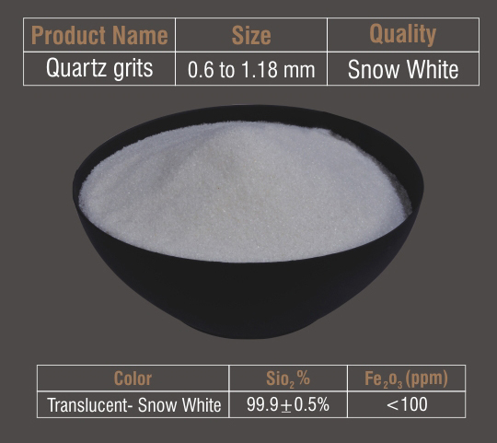
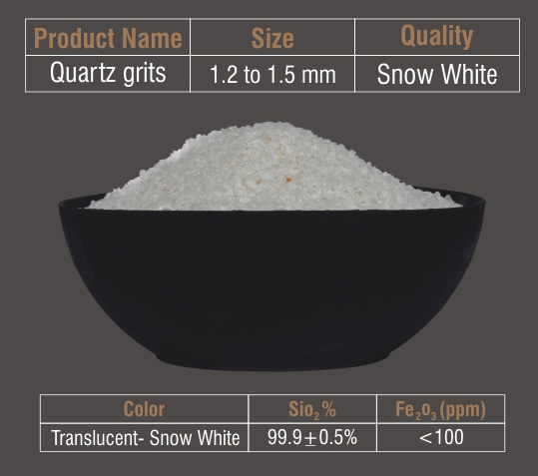
Quartz Kingdom
Snow White
Diamond stone industries

Slide 12
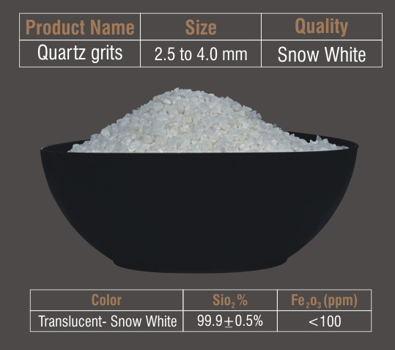
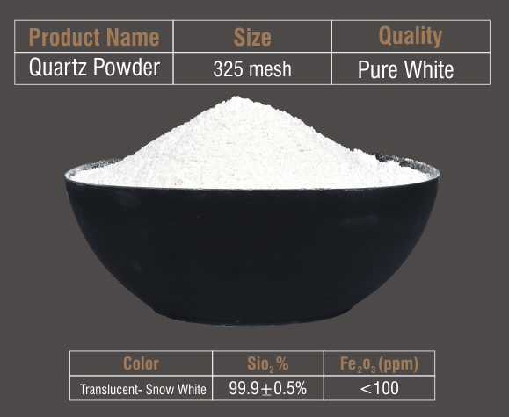
Quartz Kingdom
Snow White
Diamond stone industries

Slide 13
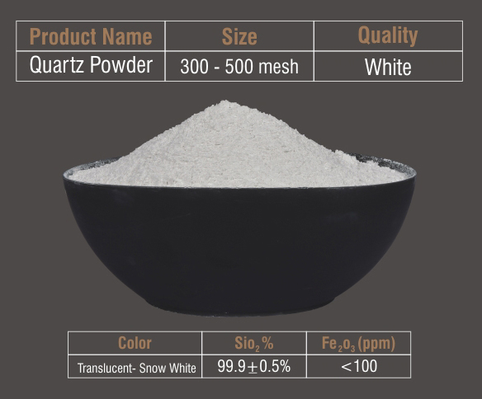
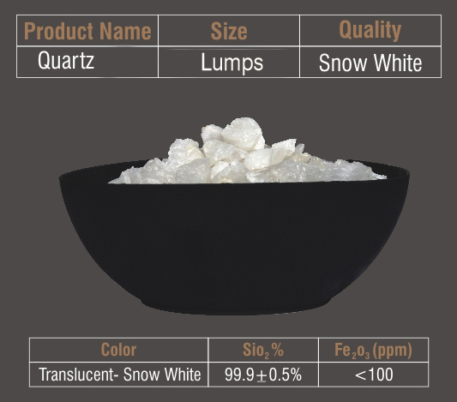
Quartz Kingdom
Snow White
Diamond stone industries

Slide 14
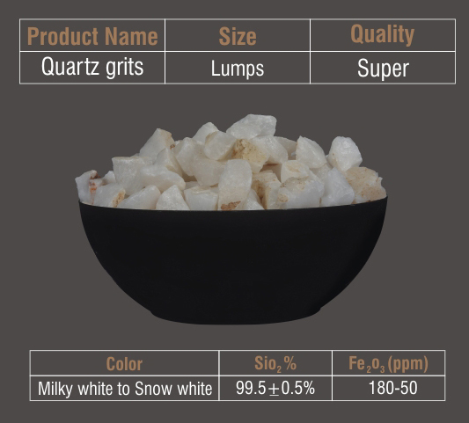
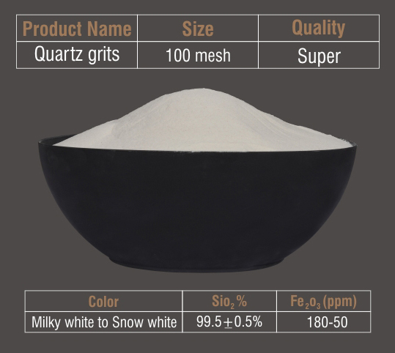
Quartz Kingdom
Super
Diamond stone industries

Slide 15
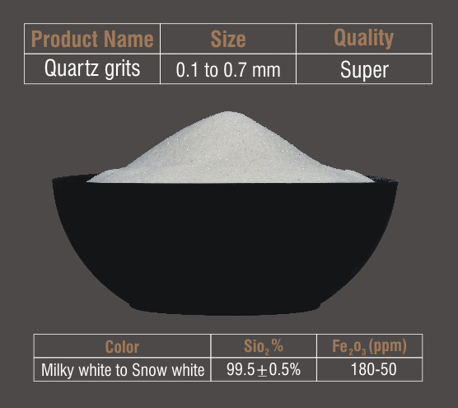
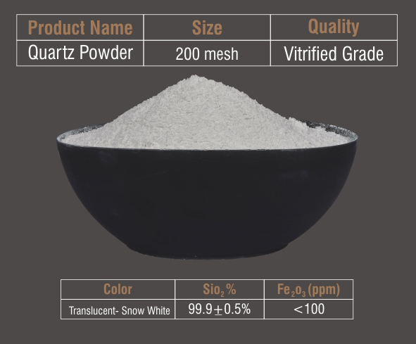
Quartz Kingdom
Super
Diamond stone industries

Slide 16
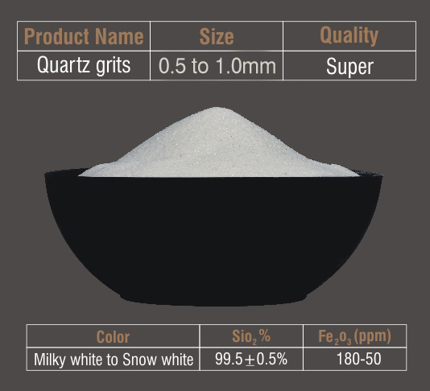
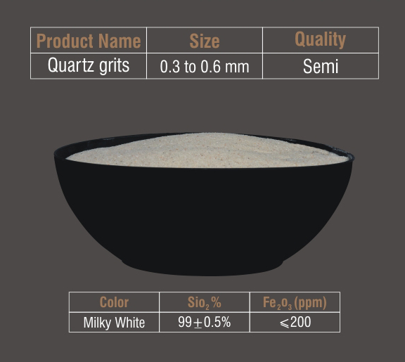
Quartz Kingdom
Semi
Diamond stone industries

Slide 17
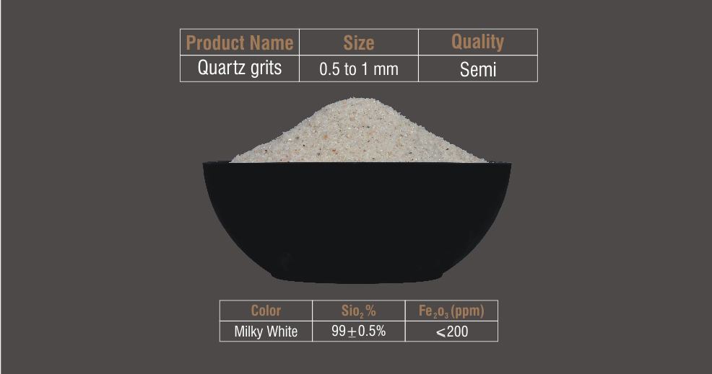
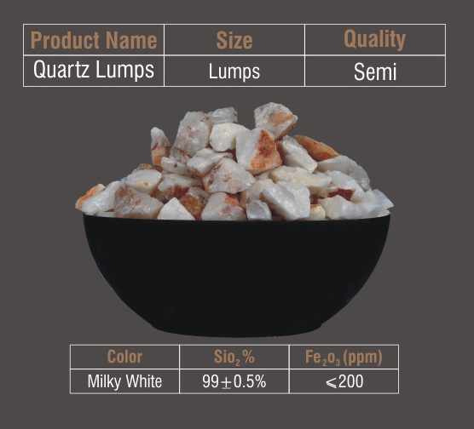
Quartz Kingdom
Semi
Diamond stone industries

Slide 18
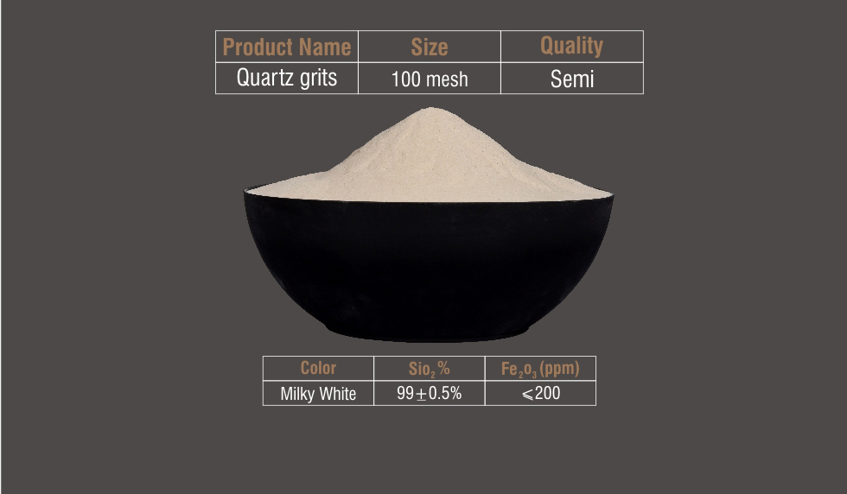
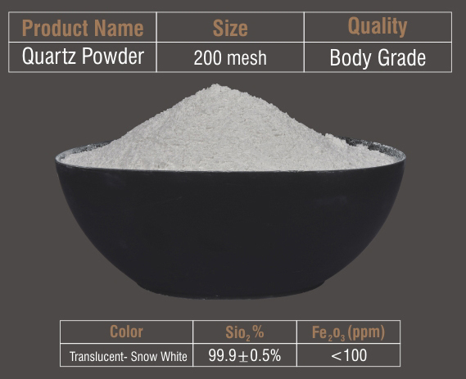
Quartz Kingdom
Semi
Diamond stone industries

Slide 19
Quartz Kingdom
Semi
Diamond stone industries

Slide 20
Quartz Kingdom
Diamond stone industries
Product Detail
Grits | 14-25 mesh | (0.6 to 1.2mm)
 | 22-52 mesh | (0.3 to 0.7 mm)
 | 25-150 mesh | (0.1 to 0.6 mm)
 | 36-150 mesh | (0.1 to 0.4 mm)
Big size grits | 5-8 mesh | (1.2 to 2.5 mm)
 | 5-8 mesh | (2.5 to 4.0 mm)
Powder | 200 mesh
 | 300 mesh
 | 325 mesh 400 mesh
lumps | As per client requirement
packaging | 50 kg. New h.d.p.e bag
 | Jumbo bag
 | Bulk loose

Slide 21
Quartz Kingdom
Diamond stone industries
Physical Properties of Quartz
colour | Quartz occurs in virtually every colour common colours are clean, white gray, purple, yellow, brown, pink, green, red
streak | Colourless ( harder than the streak plate)
lustre | Vitreous
diaphaneity | Transparent to translucent
cleavage | None-typically break with a conchoidal fracture
Mohs’s hardness | 7
Specific gravity | 2.6 – 2.7
Distinguishing characteristics | Conchoidal fracture, glass lustre, hardness
Chemical composition | Sio2
Crystal system | hexagonal

Slide 22
Chemical Properties of Quartz
Quartz Kingdom
Diamond stone industries
Grade | q1 |  | q2
Sio2 | 99.9% | (+ or – 0.2) | 99% | (+ or – 0.25)
Ai2o3 | 0.2% | (+ or – 0.1) | 0.4% | (+ or – 0.2)
K20 | 0.001% | (+ or – 0.5) | 0.10% | (+ or – 0.1)
Na20 | 0.1% | (+ or – 0.1) | 0.1% | (+ or – 0.5)
Fe203 | 0.01% |  | 0.04% | (+ or – 0.2)
Mgo | Nil |  | Nil
Cao | Nil |  | Nil
tio2 | nil |  | nil

Slide 23
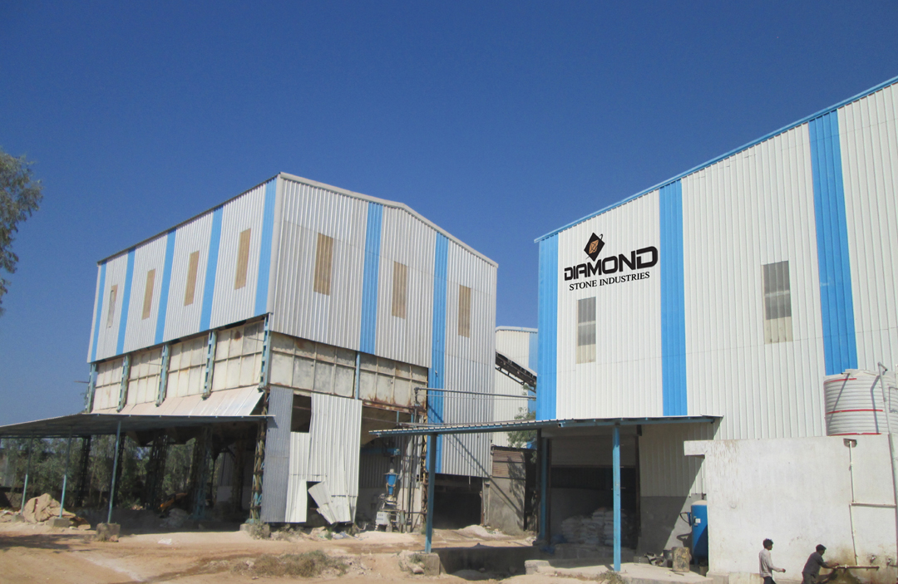
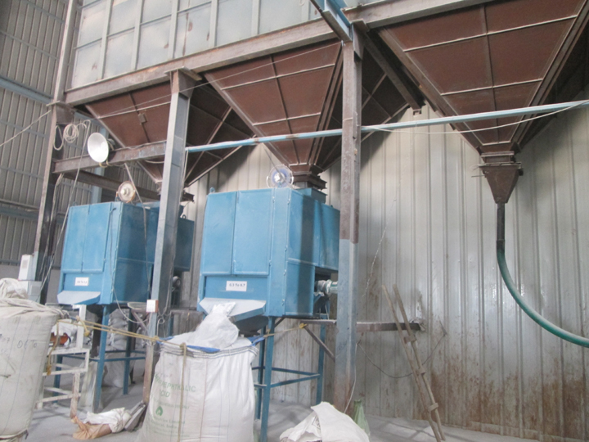
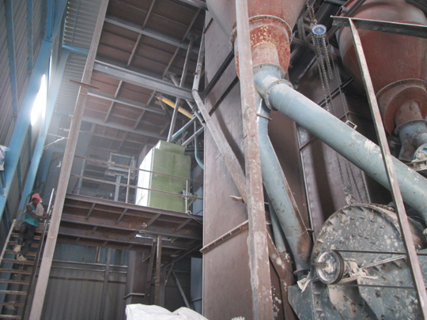
DIAMOND STONE INDUSTRIES PLANT 2- At MALPUR
Quartz Kingdom
QUARTZ PROCESSING MACHINE 1
QUARTZ PROCESSING MACHINE 2

Slide 24
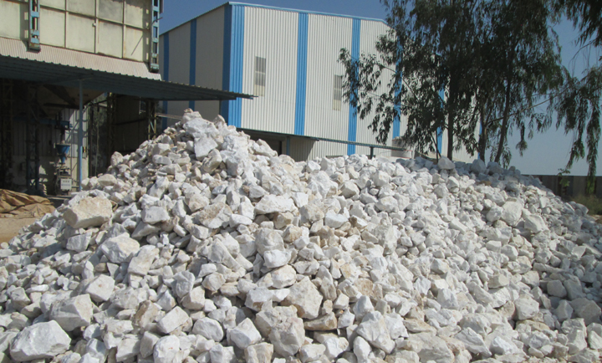
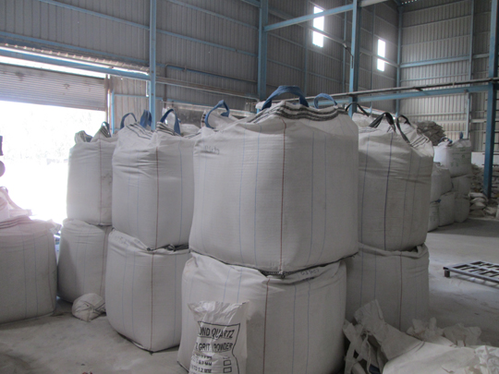
Quartz Kingdom
QUARTZ PROCESSING MACHINE 2
DIAMOND STONE INDUSTRIES PLANT 2- At MALPUR-STOCK YARD

Slide 25
Quartz Kingdom
DOMESTIC CLIENTS
QUARTZ STONE UNIT
NAME PLACE STATE
1 ASIAN GRANITO INDIA LIMITED HIMATNAGAR GUJARAT
2 CLASSIC MARBAL COMPANY PVT LTD SILVASA GUJARAT
3 ANTIQUE MARBONITE PVT LTD . MORBI GUJARAT
4 RENSHOU INDUSTRIES MORBI GUJARAT
5 STATUS SERAMIK INDIA PVT LTD PRANTIJ GUJARAT
6 ARGIL CERAMICS MORBI GUJARAT
7 KEROS STONE LLP MORBI GUJARAT
8 PEARL QUARTZ STONE PVT LTD MORBI GUJARAT
9.CUARZO UDAIPUR RAJASTHAN
10.CAMROLA QUARTZ LTD HIMATNAGAR GUJARAT
CERAMICS / SANITARY
NAME PLACE STATE
1 EXXARO CERAMICS VADODARA GUJARAT
2 COLOROBBIA CHEMICALS INDIA PVT LTD SANAND GUJARAT
3 MURUGAPPA MORGAN THERMAL CERAMICS LTD KALOL GUJARAT
4 SIMPOLO VITRIFIED PVT LTD MORBI GUJARAT
5 ASIAN TILES LTD IDAR GUJARAT
6 KETHROS TILES PRIVATE LIMITED TALOD GUJARAT
7 CERA SANITARY KALOL GUJARAT
Client List

Slide 26
Quartz Kingdom
DIAMOND STONE INDUSTRIES
Client List
DOMESTIC CLIENTS
GLASS FACTORIES
NAME PLACE STATE
1.PIRAMAL GLASS LIMITED ` BARODA GUJARAT
2.HALDYAN HEINZ FINE GLASS PVT LTD SURAT GUJARAT
SILICATE FACTORIES
1.ADVATECH INDUSTRIES PVT LTD MEHSANA GUJARAT
2.AJITA SIL CHEM MEHSANA GUJARAT
FOR LUMPS
1.HINDALCO INDUSTRIES LTD BHARUCH GUJARAT

Slide 27
Quartz Kingdom
DIAMOND STONE INDUSTRIES
Client List
OVERSEASES VALUED CLIENTS
NAME COUNTRY
1.GULF STONE S.O.A.G. OMAN
2.GULF ADDITIVE FACTORY, QATAR
3.TAQWA TRADE INTERNATIONAL, BANGLADESH
4.ROYAL CERAMIC, BANGLADESH
5.RUKN AL FARES TRADING CO LLC, UAE
6.PHU SON JOINT STOCK CO., VIETNAM
7.VIETNAM QUARTZ JOINT STOCK CO., VIETNAM
8.CROWN JOINT STOCK CO., VIETNAM
9.QATAR BUILDING CO., QATAR
10.XIAMEN MILTON INDUSTRIAL & TRADING CO. CHINA
11.CHQ (XIAMEN) TRADING CO. LTD., CHINA

Slide 28
Sister Companies ( For Quartz Mines)
Quartz Kingdom
PMP SYSTEM INC.
Work Address :
Survey No.105, Kakachia,
Taluka- Lunawada,
Dist- Panchamahal,
State: Gujarat, India
AREA : 10.00 HECTARES
CERTIFICAT OF MINES :
2793 DATE : 01/08/1995
RESERVE QUARTZ STOCK
23,92,200 MT
SIDDHI VINAYAK MINES & MINERALS
Work Address :
Near Kotari, Ramnagara,
Dist. Rajsamand
State: Rajasthan, India
AREA : 4.1447 HACTERES
CERTIFICAT OF MINES :
ML NO -132/2007/961 DATE:- 02/04/2008
RESERVE QUARTZ STOCK
13,26,498 MT

Slide 29

Quartz Kingdom
REGISTERED OFFICE ( CORROSPONDENCE )ADDRESS
3,SHIV BUNGLOWS, NR.GAYATRI MANDIR ROAD,MAHAVIRNAGAR,
HIMATNAGAR,PIN CODE -383001,
DIST : SABARKANTHA,GUJARAT,INDIA
EMAIL ID :- markexim2010@gmail.com / diamondstoneindustries@gmail.com
CONTACT NO. +91-76240 71000 / +91-97234 53701
www.diamonstoneindustries.com
FACTORY ADDRESS
AT – GOVINDPURA KAMPA, NR. TOLL PLAZA MALPUR LUNAWADA ROAD, PO:-PIPRANA,TA: MALPUR,
PIN CODE :383345,
DIST: ARAVALI,GUJARAT.INDIA

Slide 30
Thank You……
Quartz Kingdom

